Slide 1
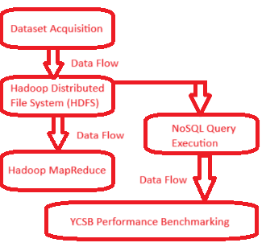
Data Storage Solutions – Hadoop – MongoDB - YCSB
Introduction
This project is for demonstrates interactions of programs and collecting data from Dataset, interactions between Hadoop, MongoDB.
System Architecture Diagram
YCSB Benchmarking results(50.000 records). YCSB performed with YSBC. MongoDB hosted using Docker for better
Isolation and reproducibility. Workload was configured to count=50.000.
Dataset Overview
Electric-Vehicle.csv was obtained, online from www.data.gov, it has 24700 records about electric vehicle.
Objective
Analyse electric vehicle registration patterns and performance of NoSQL Storage under realistic workloads
Results & Analysis
Workload A (read/Write balanced)
Shows stable performance with moderate
latency.
Workload B (read-heavy) had the best
read performance.
Workload C ( read-only/confirms
MongoDB’s read optimization with low
latency.
Docker ensured a clean and reproducible
environment, which was critical for
isolating Mongodb
During benchmarking
Storage Framework a Docker
Hadoop HDPS for distributed storage. MongoDB- inside Docker as the NoSQL database, data processing via Hadoop
MapReduce. Querying using YCSB MongoDB Shell.
Benchmarking using YCSB.
Performance Benchmarking
 | Throughput | Read | Update
WorKload | (Ops/Sed) | Latency | Latency
A | 239.89 | 3963.83 | 3193.89
B | 241.31 | 2962.88 | 3922.07
C | 236.25 | 2874.96 | N/A
Each test was performed using YCSB.
MongoDB was hosted using Docker.
Each workload was configured to use
recordcount=50.000
Leandro Guimaraes Damasceno ID 2019299
https://github.com/LeandroGD2017/RepeatCA-Muhammad

